Slide 1
Software Lab Presentation - Group 25
Munich, 9 May 2025
TUM School of Engineering and Design
Speaker: Nien-Ying (03803153)

Slide 2

Festo Plant for Discrete Manufacturing:
Developing Simulation Models for Industrial Copilots
Presentation by MSc. Computational Mechanics students:
Adrián Almohalla (03804037)
Eduardo Silva (03805057)
Nien-Ying Lin (03803153)
Monitored and coordinated by:
Mohamed Khalil
Speaker: Nien-Ying (03803153)

Slide 3
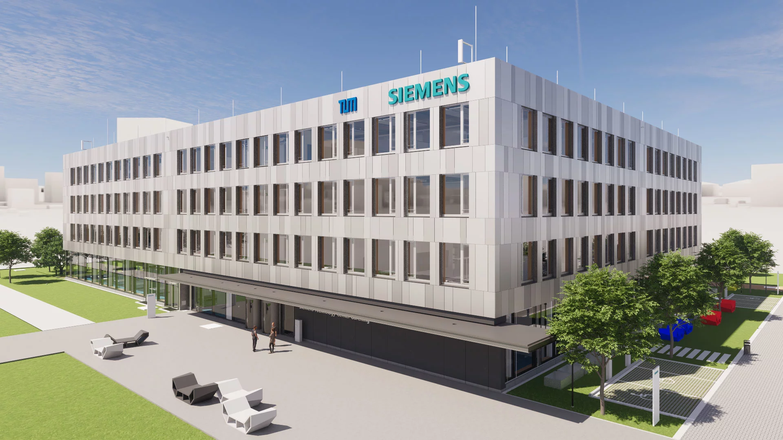

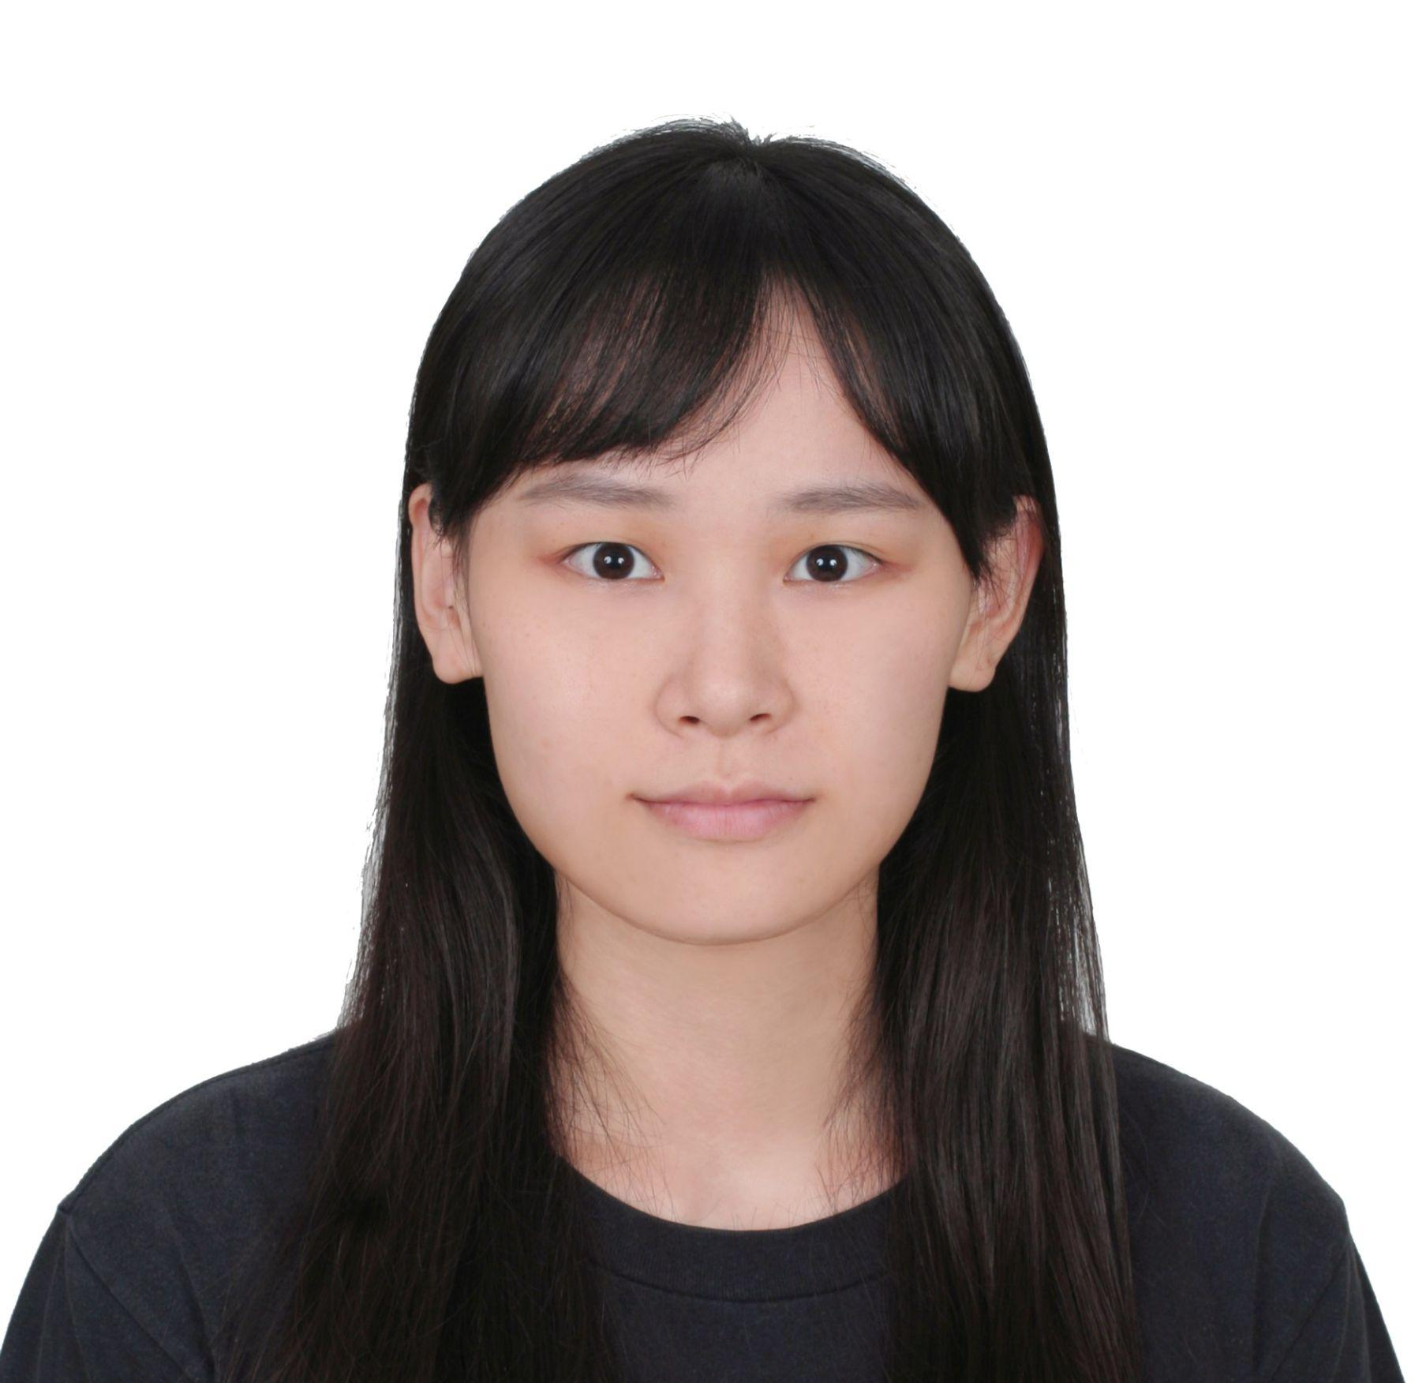

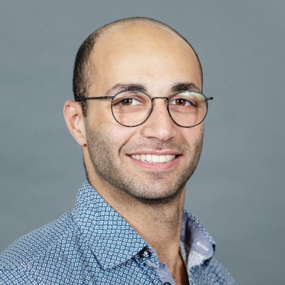
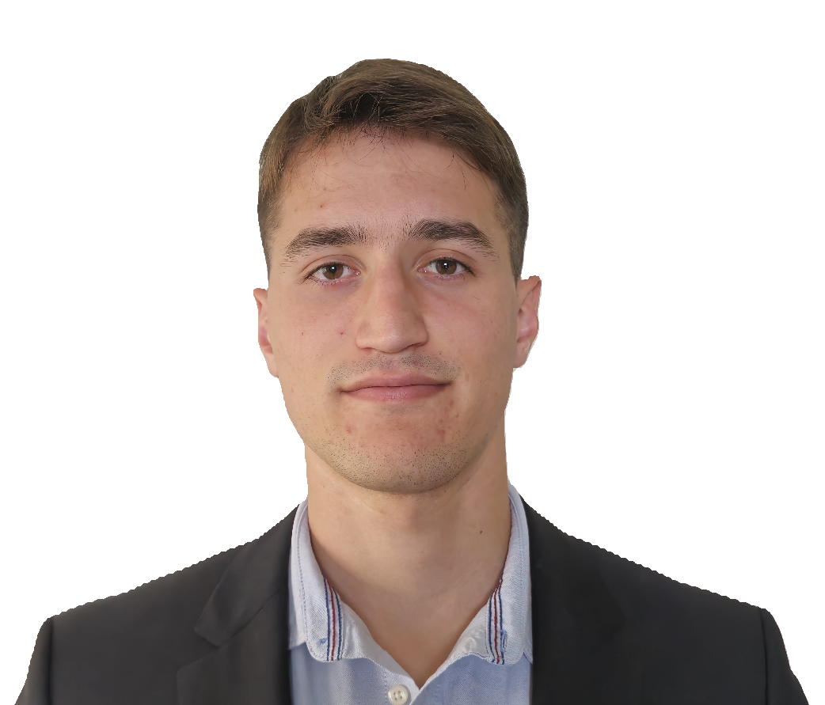
Team Responsible for Project
Siemens Technology Center (Garching)
Eduardo Silva
Nien-Ying Lin
Mohamed Khalil
khalil.mohamed@siemens.com
Adrián Almohalla
Speaker: Nien-Ying (03803153)

Slide 4





Motivation & Problem
Overview
Our Approach
Agent System Design
Methodology
Timeline
Speaker: Nien-Ying (03803153)

Slide 5
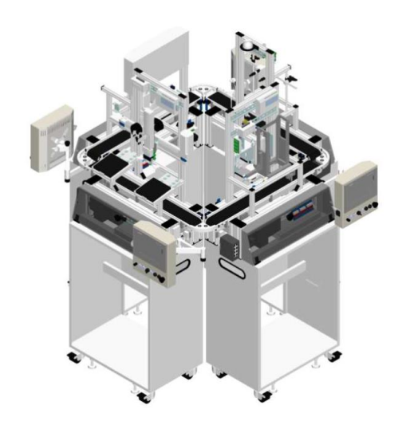
Introduction to the problem
Motivation:
Manufacturing must become more efficient and sustainable.
Problem:
Drilling consumes a lot of energy.
Existing simulation tools are complex and not accessible to non-experts.
Issues concerning drill tool wear, quality and optimization.
What We Need:
A smart, user-friendly system for real-time, energy-aware decisions.
Fig.1 - Festo Plant Drilling Station [1]
Speaker: Nien-Ying (03803153)
Notes:
Explain here what the problem is.
Use the documents from Siemens that they gave us for the software lab to explain what the problem is.

Slide 6
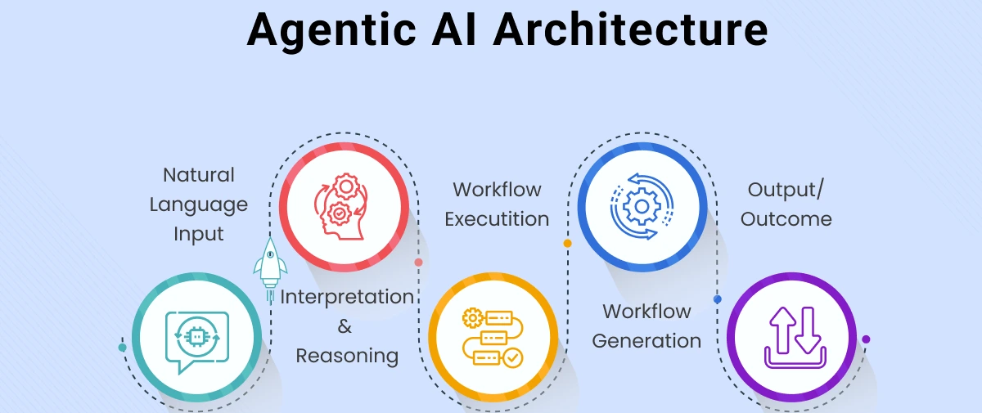
Our idea to fix it
Develop an LLM-Agent system to respond to user queries.
AI capable of solving and understanding simulations for various cases.
Fig.2 - Sample Workflow for Agent [2]
Speaker: Nien-Ying (03803153)

Slide 7





Example User Case
“What is the expected energy consumption for a drilling process using an iron drill on a copper plate? And how does it change with time?
“How much wear can I expect this experiment to cause to my drilling tools?
“If I use X material, how does it change the quality of my drilling? And how can I optimize it?”
Figs. 3,4,5,6 - User Case Icons
Speaker: Nien-Ying (03803153)

Slide 8
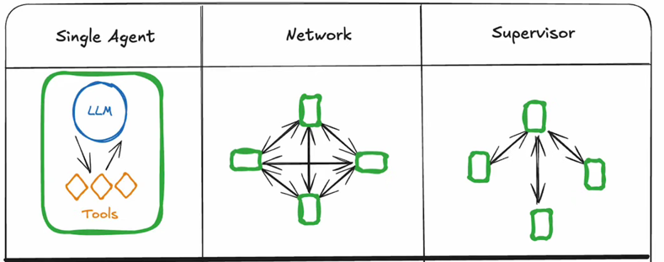
LangGraph
Open source library within the LangChain ecosystem.
Designed for building stateful multi-agent systems to handle complex non-linear workflows.
Benefits of Multi-Agent system:
Modularity;
Specialization;
Control of agent communications;
Fig. 7 - Multi-Agent Architectures [3]
Speaker: Eduardo (03805057)

Slide 9
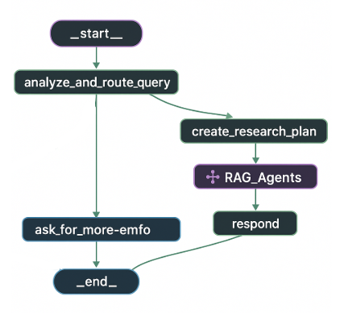
Multi-Agent RAG in ReAct Workflow
Main idea is to create a environment with multiple RAG Agents commanded by ReAct Agent:
Retrieval-Augmented Generation handles tools from companies datasets;
ReAct handles communication between tasks and RAG Agents.
ask_for_more_info
Fig. 8 - Multi-Agent RAGs [4]
Speaker: Eduardo (03805057)
Notes:
Agents to develop:
Energy
Wear
Quality
Optimization

Slide 10
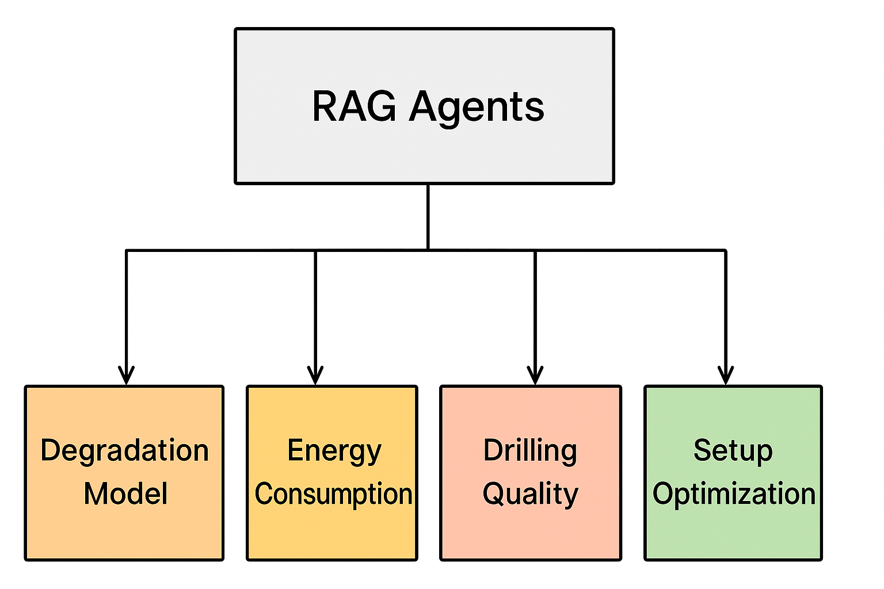
Agents Specializations
Degradation Model: Agent specialized in estimating the degradation of our drilling tool, based on material and setup parameters.
Energy Consumption: Responses regarding the average of energy used for every operation using the Festo Plant.
Drilling Quality: Quantitative and qualitative analysis of drilling for different experiments.
Setup Optimization: How to upgrade our setup regarding all the aspects mentioned above.
Fig. 9 - RAG-LLMs Tools
Speaker: Eduardo (03805057)

Slide 11
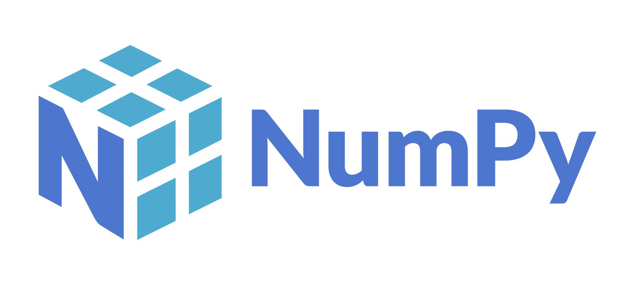

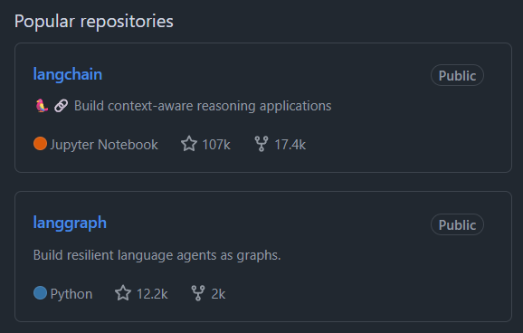

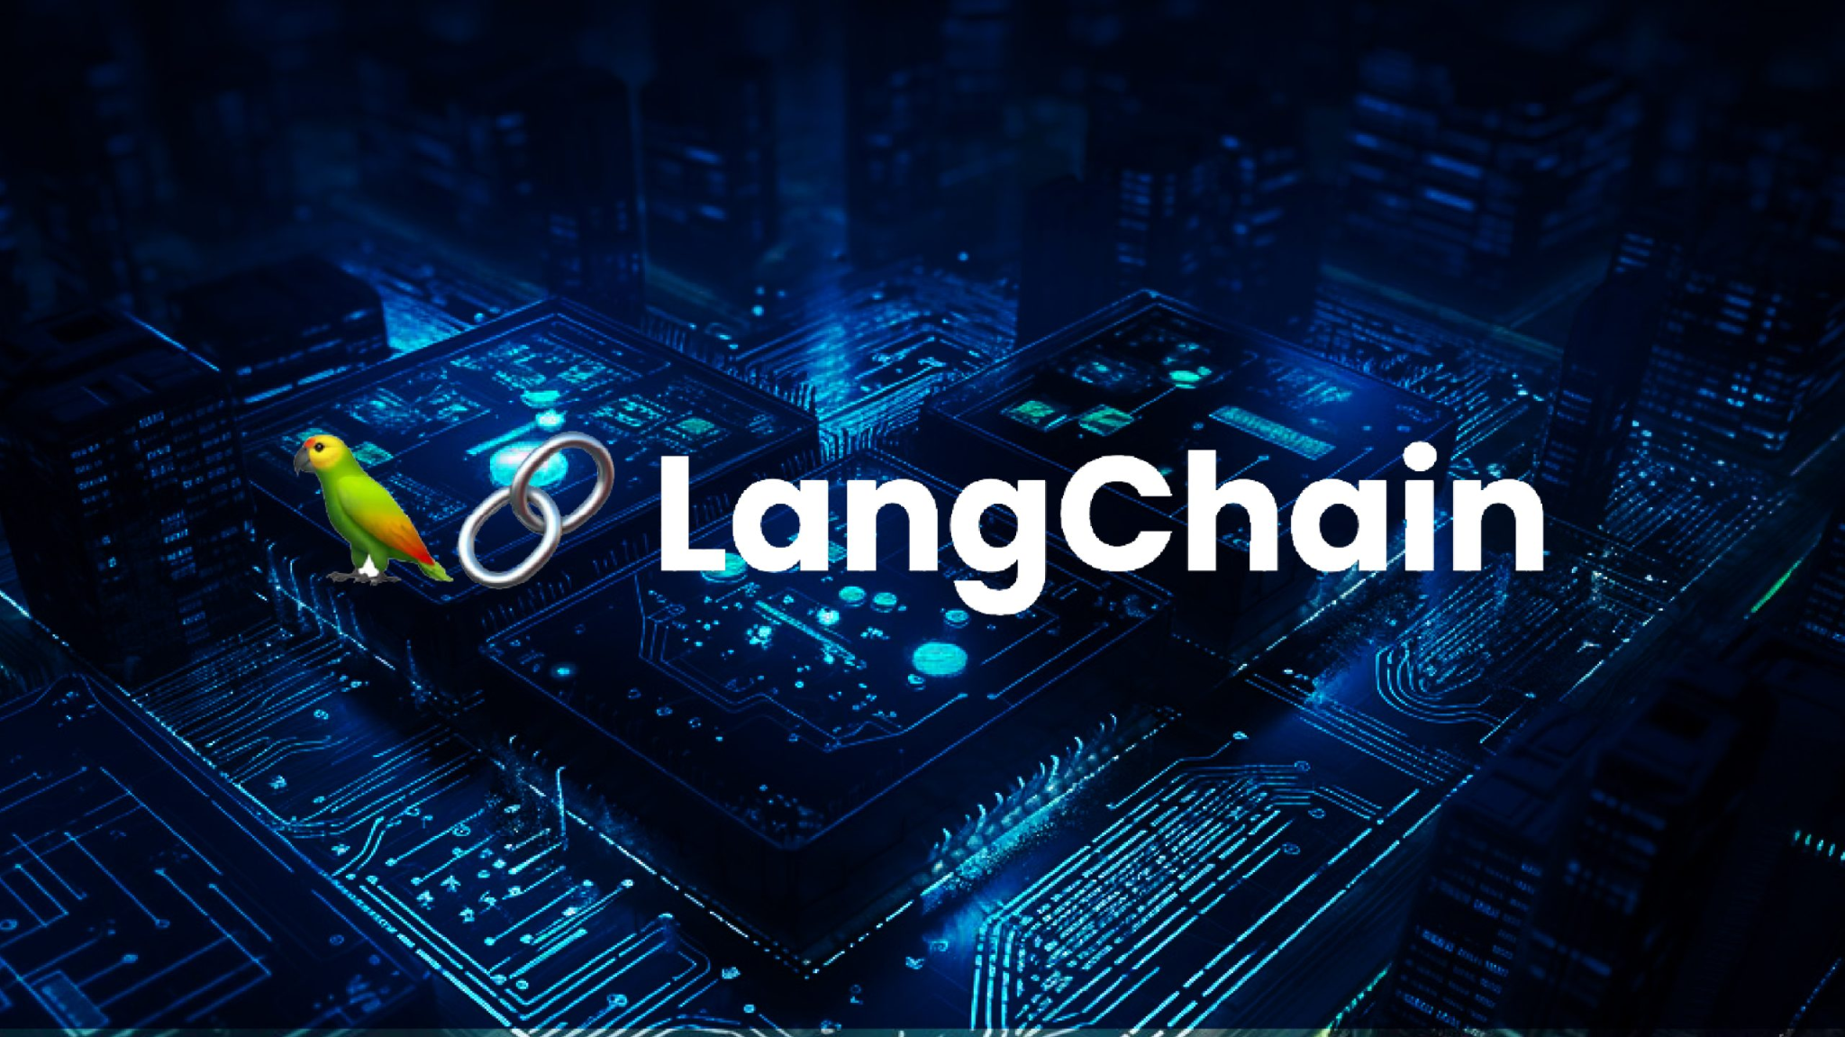

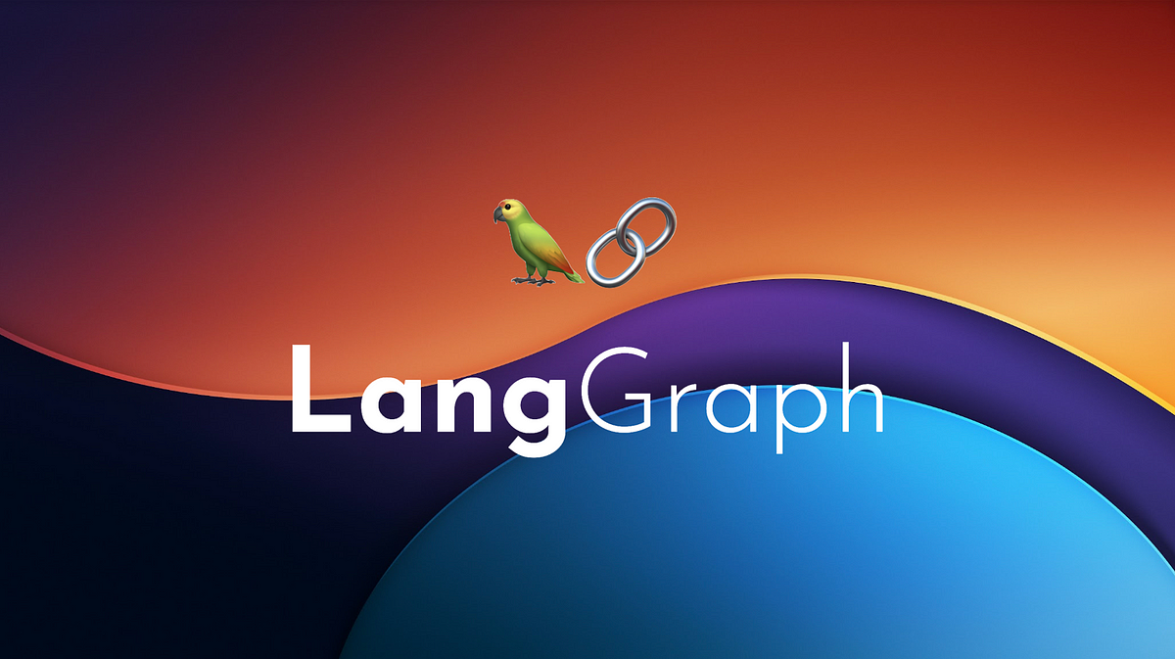


Additional Libraries/Products
Speaker: Eduardo (03805057)

Slide 12
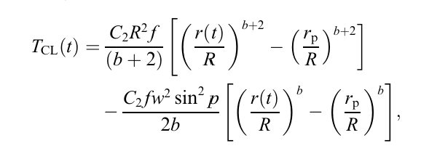
Initial Tools/Models for the Agents
Degradation model
Energy consumption model
Based on torque
Provided model
[1]
Speaker: Eduardo (03805057)

Slide 13
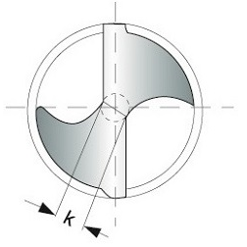
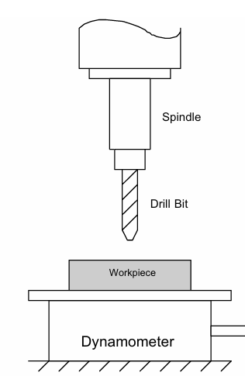
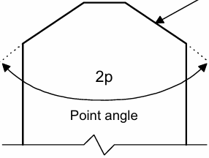
Degradation Model Explanation
[1]
Tcl = maximum torque achievable
C2 and b = model coefficients (estimate wear)
R = drill radius
f = feed rate
w = web thickness
p = point angle
r(t) = variable radial position along the cutting edge of the drill
rp = pre-hole to guide and reduce the load on the larger drill (can be approached to w/2 if not pilot hole used)
w
Tmeasured
Fig. 10,11,12 – Drilling Schemes [1]
Speaker: Adrián (03804037)

Slide 14
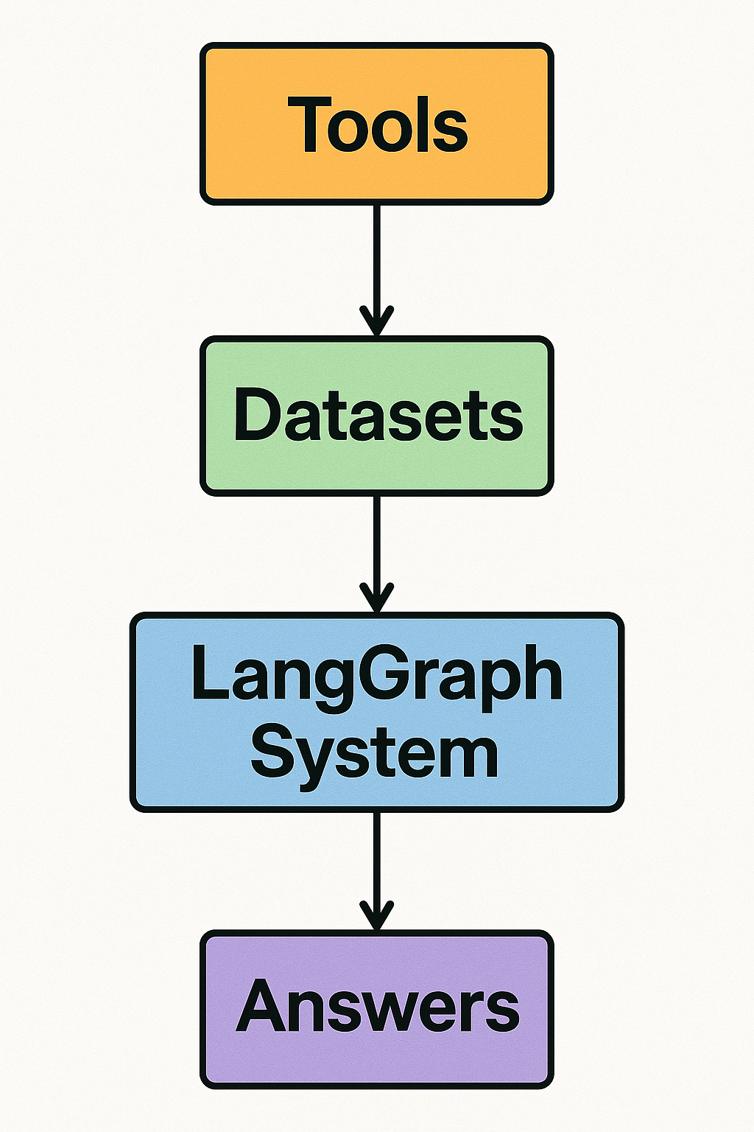
Methodological Approach
1 - Find relevant literature for tools (equations and models)
2- Incorporate these models as tools for the LLM-agent system
3 - Train these tools with internal datasets provided by Siemens.
4 - Query the LLMs, evaluating and optimizing the quality of answers
Speaker: Adrián (03804037)

Slide 15
Timeline
Start of Refinement Stage
Code in final stages and decide how to make it more efficient.
01/07/2025
01/12/2025
01/09/2025
Second Presentation
Have 1 or 2 tools implemented with Langgraph System
Final Presentation
Present final results
Speaker: Adrián (03804037)

Slide 16

Documentation and Literature
Refer to our Github to get all the code, reports and documentation!
QR code leads to our Github repository.
Speaker: Adrián (03804037)

Slide 17
References
[1] - A. Ertunc and C. Oysu, “Drill wear monitoring using cutting force signals with a multilayer perceptron,” Expert Systems with Applications, vol. 23, no. 2, pp. 143–150, 2002, doi: 10.1016/S0957-4174(02)00071-6.
[2] - MobCoder - “Why Agentic AI Is the Next Frontier in Digital Transformation”.
[3] - https://langchain-ai.github.io/langgraph/concepts/multi_agent/
[4] - LangGraph Template: Multi-Agent RAG Research
Speaker: Adrián (03804037)

